Slide 1


Slide 2

gRPC Microservices & Kubernetes

Slide 3

A little bit about me
Giannis Lamis
Backend developer @ Quintessential
GitHub: github.com/darklam
Education: ΕΚΠΑ Πληροφορικής και Τηλεπικοινωνιων

Slide 4
Who we are at Quintessential
We are a relatively new software company
using cutting-edge technology
aiming to create unique user experiences

Slide 5
What tech stack will we use?
NodeJS - Event-driven JavaScript runtime
NestJS - Backend framework based on TypeScript
Docker - For building the images we’ll use on Kubernetes
gRPC
Kubernetes

Slide 6
What is gRPC and Kubernetes?
gRPC is a remote procedure call protocol developed by Google (we all know the g in the beginning stands for Google, but not officially). In a nutshell:
Supports most major programming languages (supports NodeJS, who cares about the rest)
Uses protocol buffers for data serialization (statically typed & generally faster than serializing/deserializing JSON)
Used mainly for microservice communication (please don’t use it for public APIs)
It is actually used by Google (or so they say)

Slide 7
What is gRPC and Kubernetes?
Kubernetes is a container orchestration system developed by Google to allow for easy management and scaling of online services.
Uses plain docker images in its base
Easily set rules for web traffic with many options on how to handle that
No downtime when updating apps by performing Rolling Updates
Allows private communication between services without any outside traffic
Very easy to set up Load Balancing for your services
Has internal DNS for easier communication between services

Slide 8
Whoa there chief, what are containers?
Containers in general are pieces of software that are packaged along with their dependencies so they can in theory run in any environment. Now Docker containers:
Are not VMs. They virtualize the OS, not the hardware.
If ran on the same machine they share the kernel but are isolated.
Run the same on any system, so no more “But it works on my machine”

Slide 9
NestJS - Core Concepts
Dependency Injection - Class instantiation is managed for you, along with object lifetimes which you can configure
Controllers/Services - Controllers are the functions mapped to each API route and method and services are where the operations on the data take place
Decorator pattern - Add properties to classes and objects using TypeScript’s reflection features
Opinionated - Like Angular, it is very opinionated about the project structure and recommended patterns, while providing a lot of functionality such as validation and error handling out of the box

Slide 10
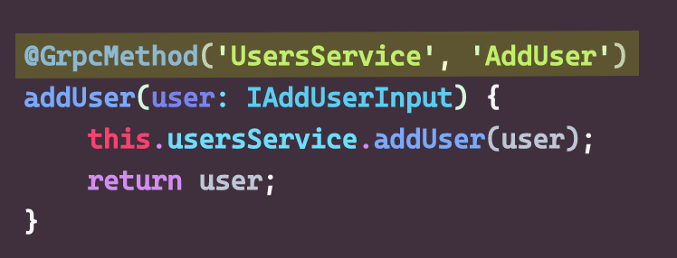
What is this? An email?
This is a decorator. It is basically a function that takes any target as an argument and adds some metadata which can be obtained later, modifies the target etc. In this case, it takes a couple of arguments and returns a function which is the actual decorator. No magic, just special syntax.

Slide 11
Docker: The Basics
You define how an image is build and its dependencies in a file, usually called Dockerfile with special syntax
When building a docker image, there is the context, which is everything Docker has access to during the build phase and it is the folder the file is in. Anything outside is inaccessible.
Registries: In order to run an image in the cloud, the remote machines need to have access to these images, that is why you need to push them to remote registries (such as the public docker registry, or other private ones).
Versioning: Every docker image has a version tag that is either a semver version or a tag, such as stable/latest etc.

Slide 12
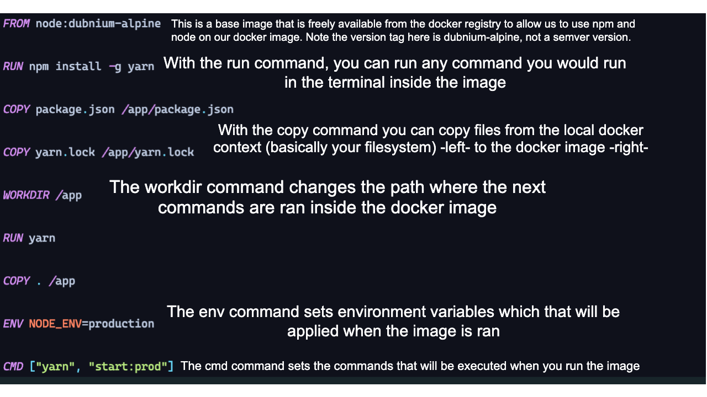
Docker: File structure

